Slide 1
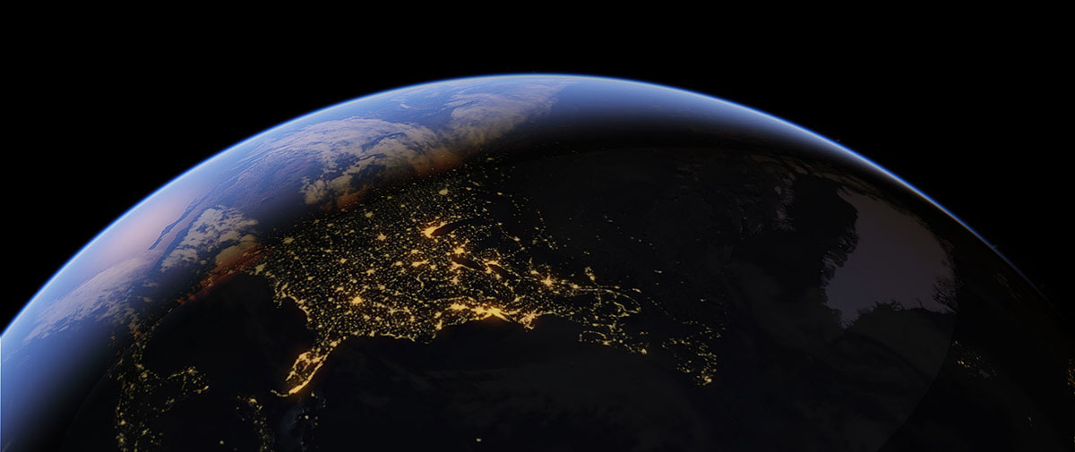


Georeferencing Specimen Localities
Elizabeth Gjieli, Geographical Information Manager

Slide 2
TABLE OF CONTENTS
1. Introduction & Mapping Tools
2. Methods & Protocols
3. Step-by-step Examples

Slide 3
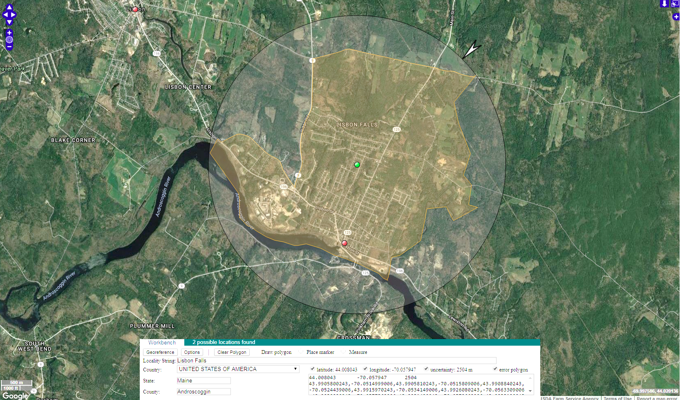

PART 1: INTRODUCTION &
MAPPING TOOLS

Slide 4
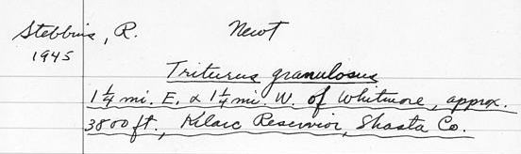
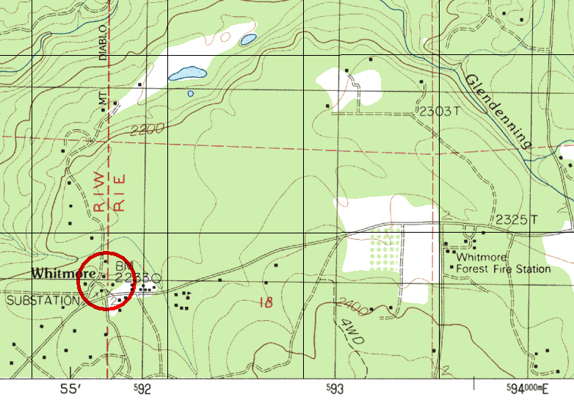
What is Georeferencing?
Interpreting a written description of a locality into mappable coordinates and an uncertainty radius in accordance with community best practices
Goals:
Find coordinates as accurately as possible
Calculate the smallest uncertainty radius that encapsulates entire area that the collection could have been within
Capture proper metadata so that georeferencing steps can be retraced and process is repeatable
Notes:
What is georeferencing?

Slide 5
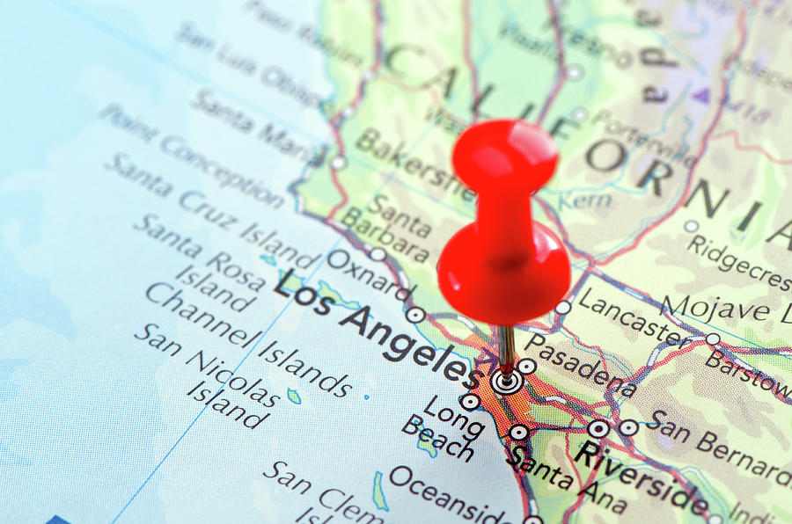
Guides
We follow community agreed upon best practices for georeferencing, which include stepwise instructions based on categorization of the locality type
Georeferencing Quick Reference Guide (2020)
Georeferencing Quick Reference Guide (2012)
Best Practices Guide (2020)
Notes:
What is georeferencing?

Slide 6
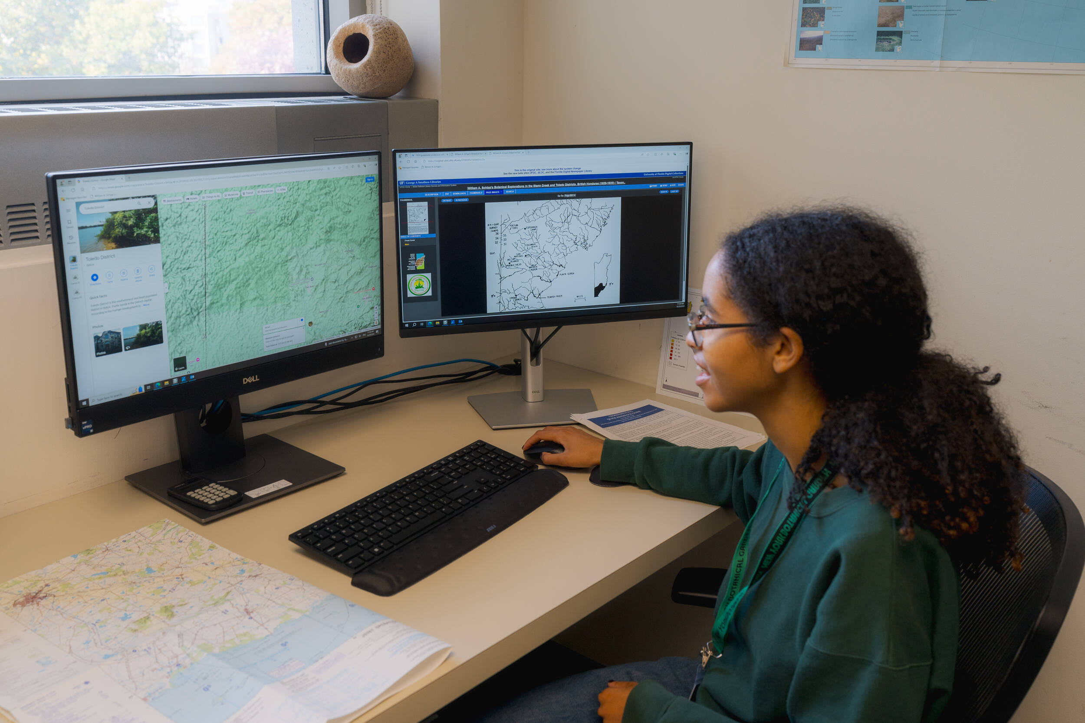
Mapping Tools
To capture coordinates and uncertainty radii, we mainly use:
Google Maps
GEOLocate
Also may be used:
Google Earth
Bing Maps
ACME Mapper
GIS software

Slide 7
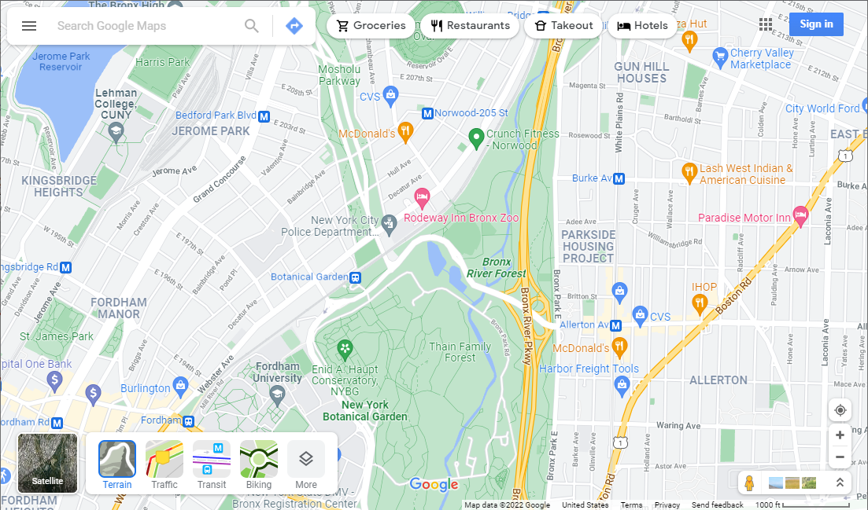
Google Maps: Map Layers
selecting the scale bar toggles between units
Geo-tagged photos

Slide 8
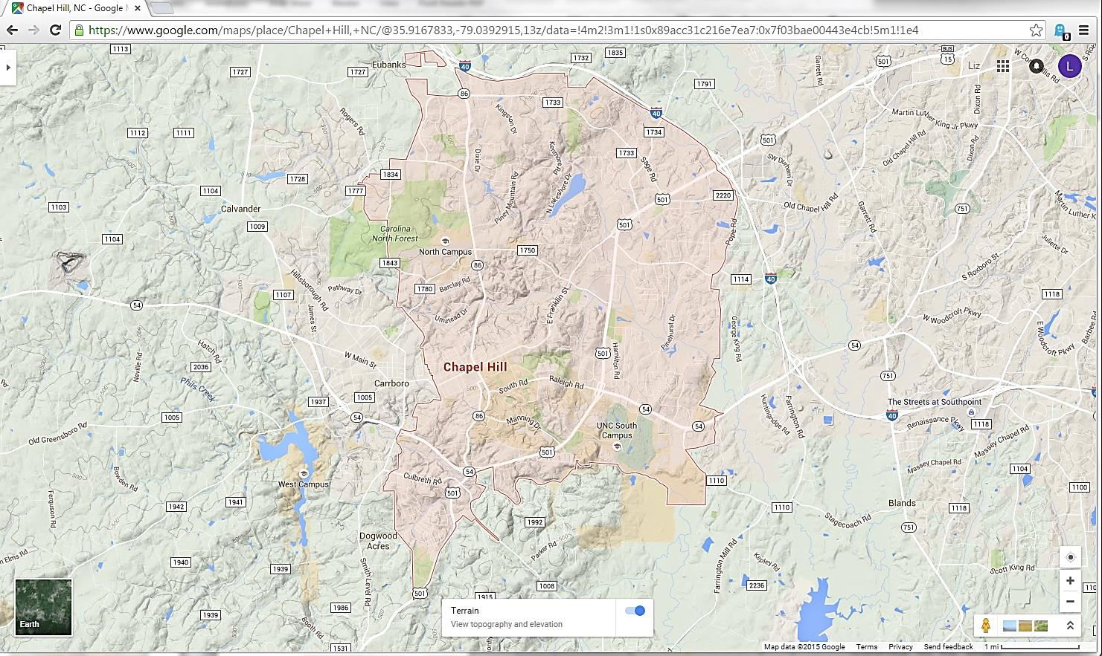
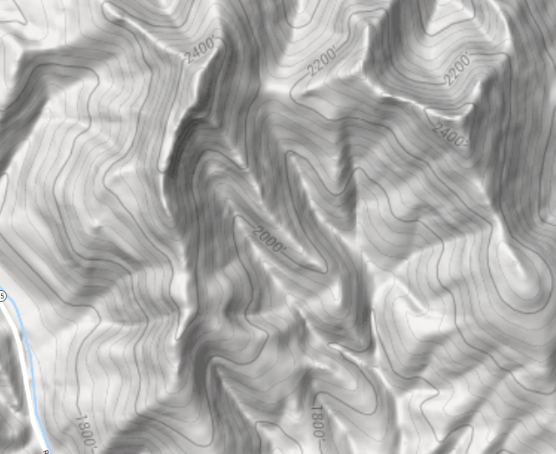
Terrain View

Slide 9
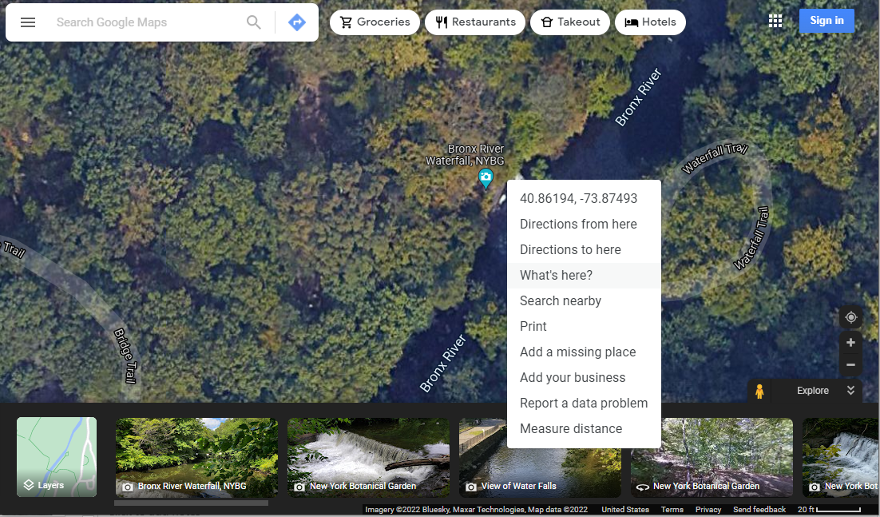

Capturing Coordinates
Coordinates are provided at top of menu – select to auto-copy. Or select “What’s here?” option to capture coordinates
Right click on a location to find coordinates

Slide 10
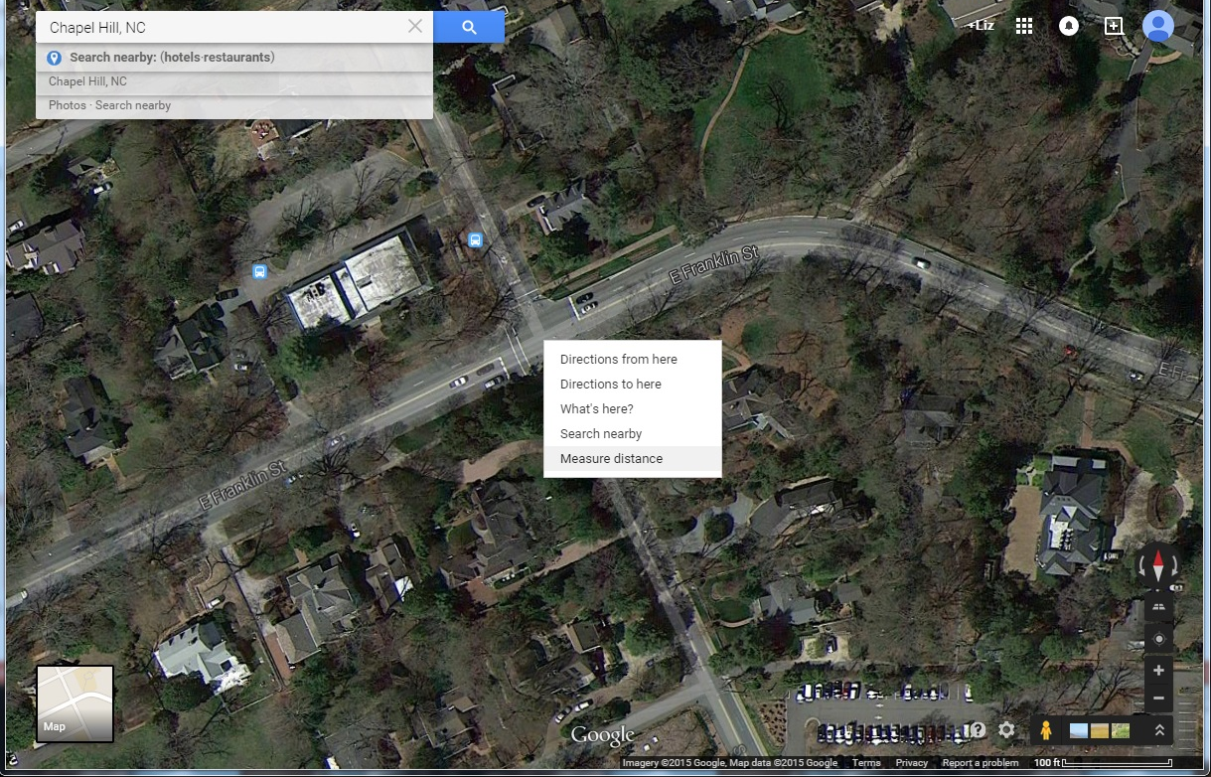
Measure Distance
Right-click on the location, select
“Measure distance”
Bonus: This tool also serves as a great way to pin a place on the map

Slide 11
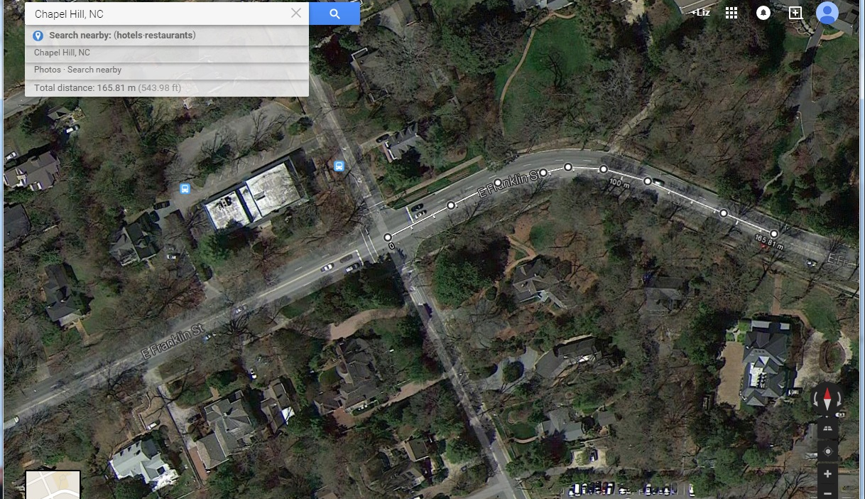

Measuring Distance
Left-click on the map to measure a linear segment. The nodes may be adjusted/deleted

Slide 12
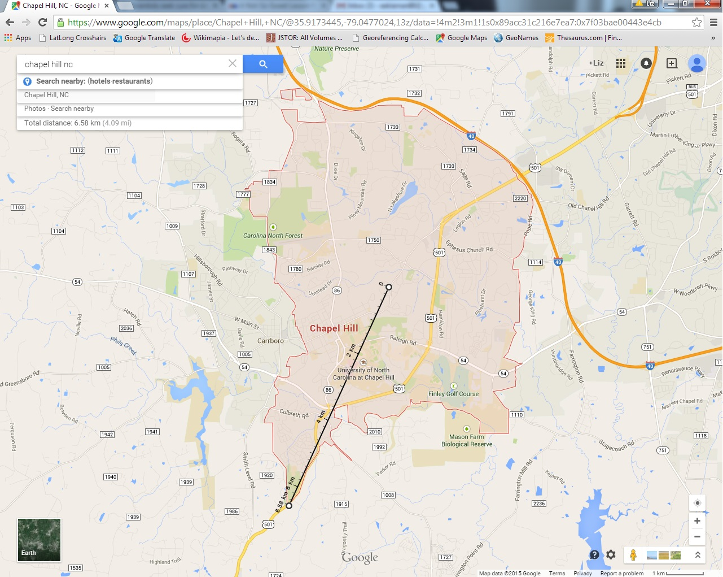
Radial
Measure Distance Tool is used to measure a feature’s radial
Radial

Slide 13
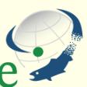
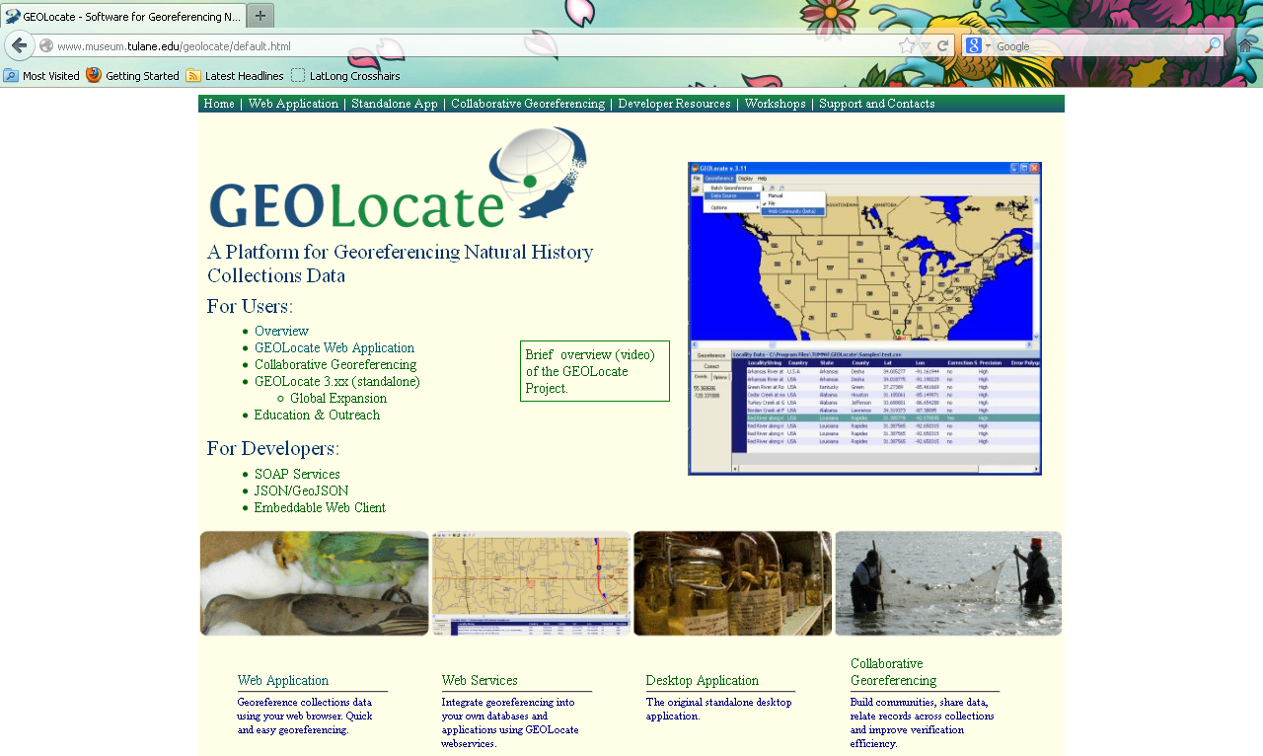
GEOLocate
http://museum.tulane.edu/geolocate/default.html
Works best for U.S., Canada, and Europe
Automates georeferencing

Slide 14
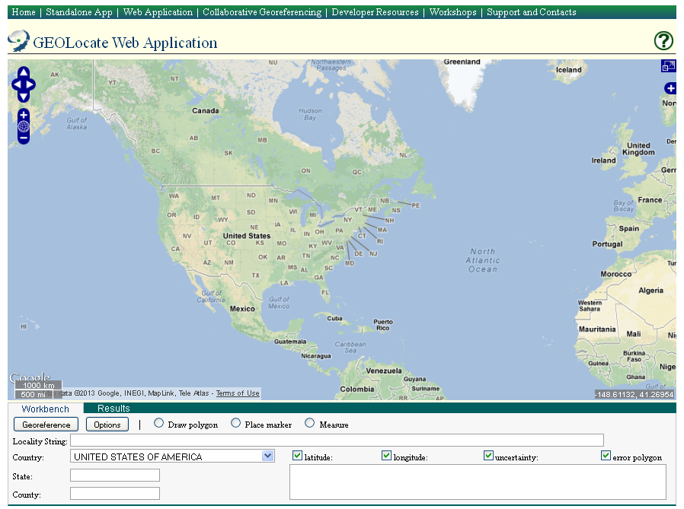
GEOLocate Web Application
Full screen view
Pan around map
Base layer and overlay options
Zoom tool
Coordinates at cursor position
Map scale
Country drop-down list
GEOLocate
Locality search fields

Slide 15
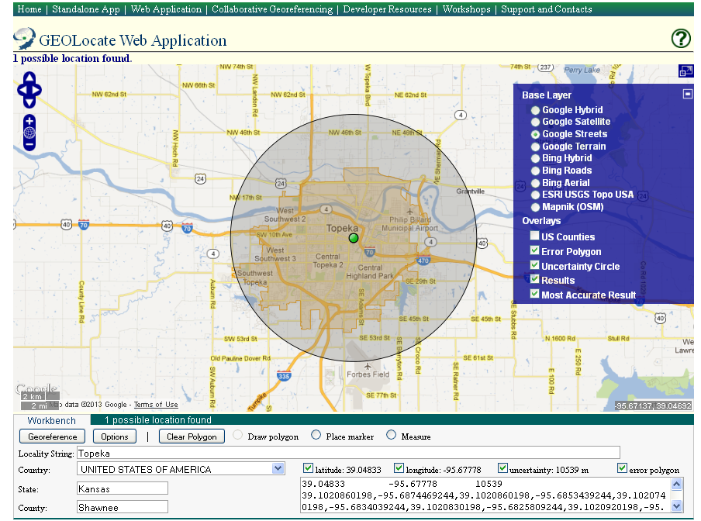
GEOLocate Web Application
Radial
Georeferenced point

Slide 16
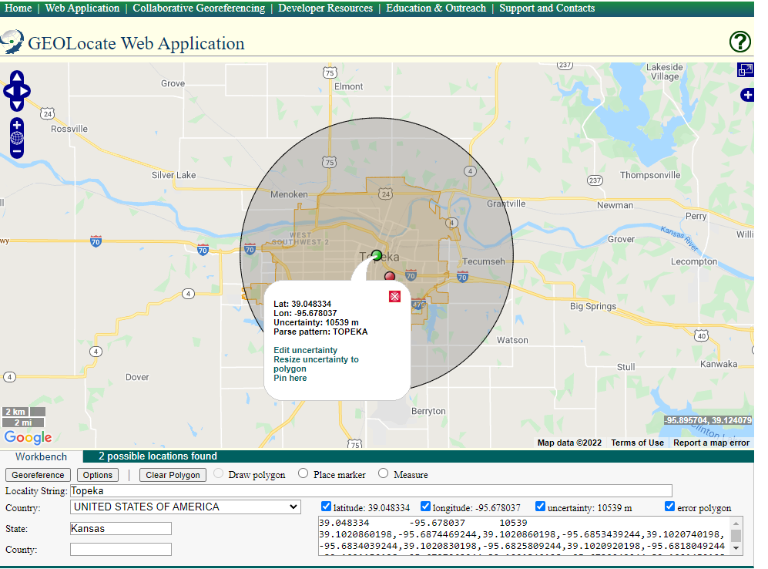
Uncertainty: Automated
Click “Resize uncertainty to polygon” to snap the radial to the region of the city (available when polygon of the feature is present)

Slide 17

Uncertainty: Manual
Click “Edit uncertainty” to manually adjust the radial. This method is more time intensive.
GEOLocate

Slide 18
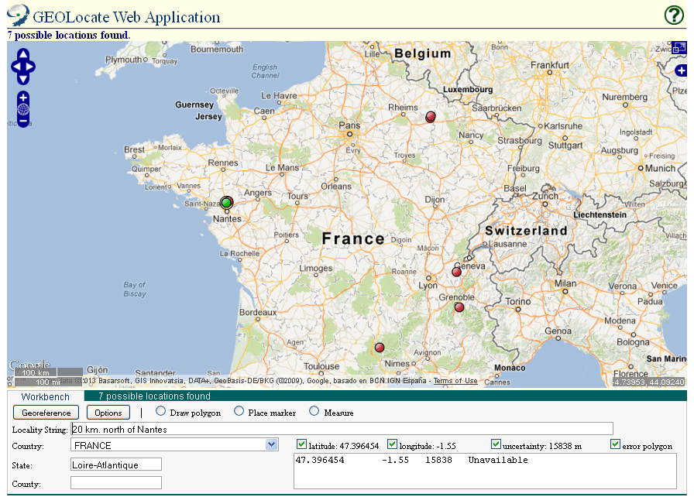
Offset at a Heading
green dot =
best match
20km N of Nantes, France

Slide 19
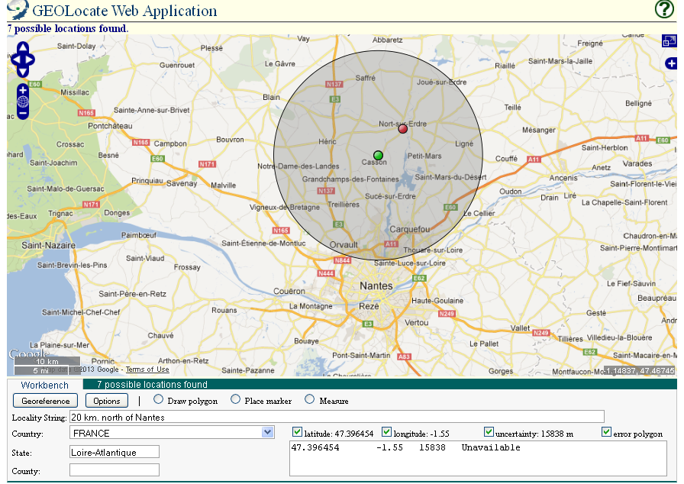
Offset at a Heading
20km N
20km N of Nantes, France

Slide 20
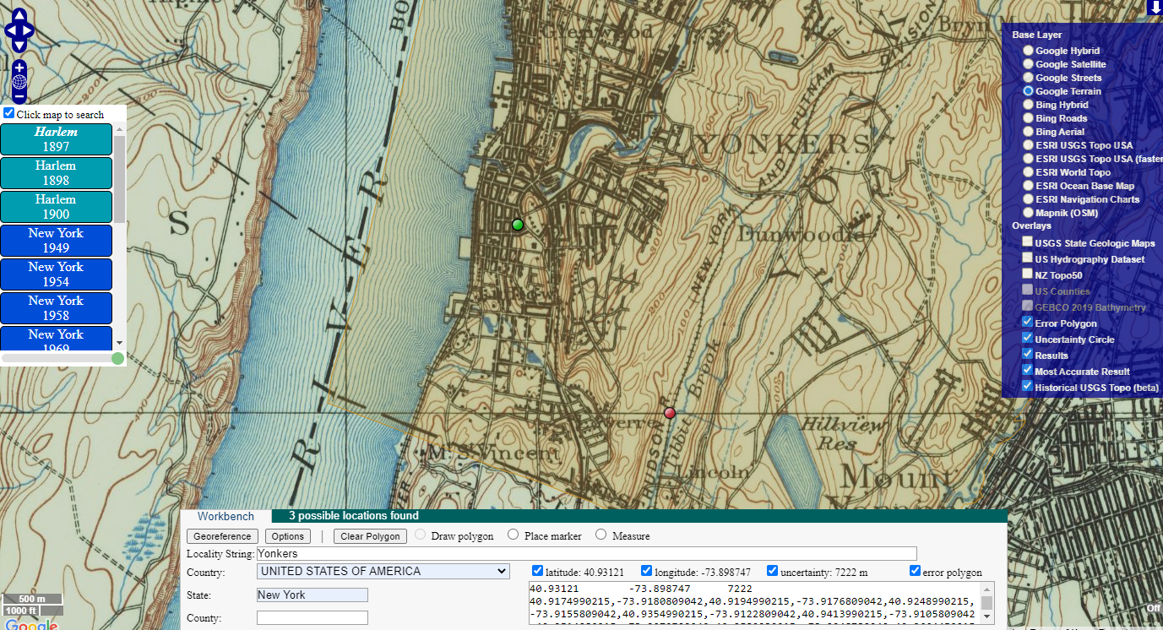
Reference Map Layers

Slide 21
Translating Coordinate Systems
Geographic coordinates are sometimes provided on labels in various coordinate systems
Decimal degrees format is the most convenient for mapping and is the standard format we capture in EMu (e.g., 40.866680, -73.878735)
Coordinate systems can be converted between one another
More information on:
Township, Range, and Section (PLSS)
UTM coordinates

Slide 22
Public Land Survey System (TRS)
Township-Range-Section Coordinate System (TRS)
  Example: T21N, R1W, S5 = Township 21 North / Range 1 West / Section 5
  State must be specified, and sometimes a meridian if a state has more than one
  Datum: NAD27
For U.S. locations only, mainly in the West, Midwest, and South
Useful tools to convert TRS to latitude and longitude coordinates: GEOLocate or TRS Conversion Calculator

Slide 23
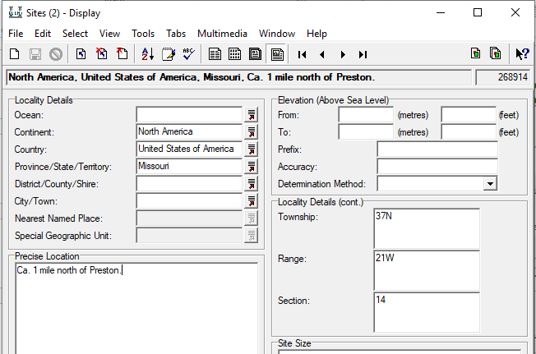
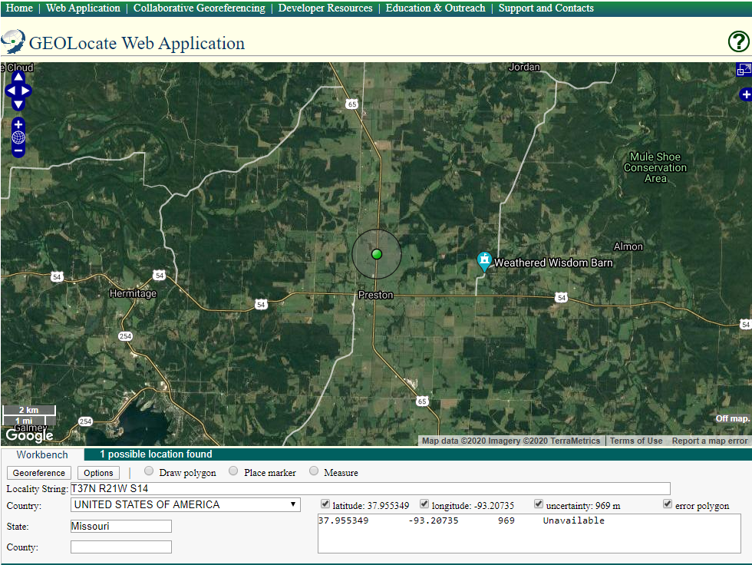
GEOLocate to Convert TRS
GEOLocate can translate TRS into decimal degrees if entered as: T(value direction) R(value direction) S(value), example: T37N R21W S14

Slide 24
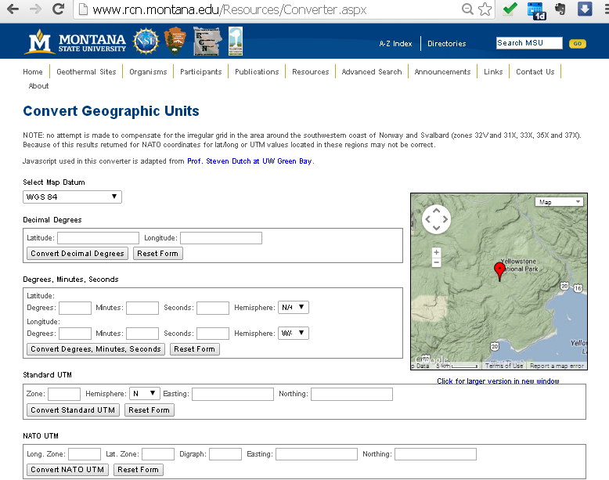
UTM Calculator
To use when coordinates provided on label in UTM format
What is UTM?
Universal Transverse Mercator coordinate reference system
Conversion Website
Notes:
To convert UTM to latitude/longitude, use the RCN UTM Calculator

Slide 25
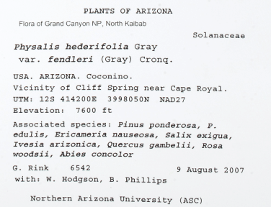
UTM Calculator
Lat/Long Coordinates
Search fields
Note: This information is captured in the Mapping Tab of the Sites Module in EMu
Standard UTM coordinates
NATO/Military Grid Reference System UTM
Conversion Website
Notes:
To convert UTM to latitude/longitude, use the RCN UTM Calculator

Slide 26
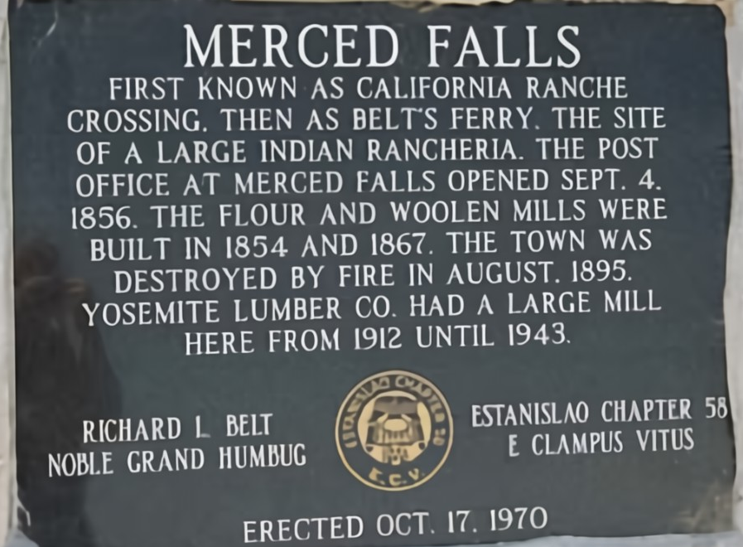
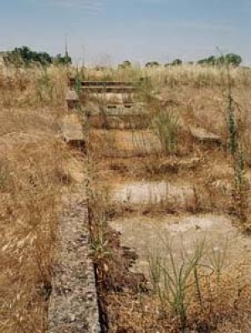
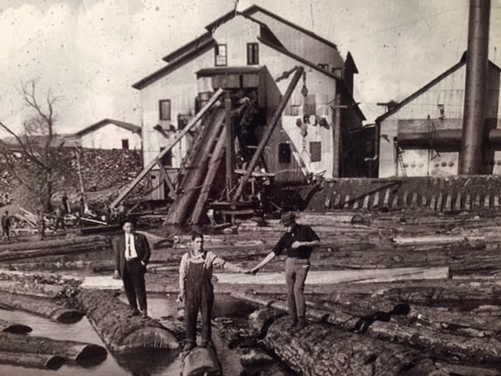
Digital Resources
Often necessary to reference gazetteers or other sources
  Historical places or ghost towns
  Remote areas
  Natural/geological features
  Spelling/translation variations
present day
c.1900
Example: Merced Falls, California

Slide 27
Digital Resources
GeoNames: geographical database, crowdsourced
Wikimapia: online editable map, crowdsourced
OpenStreetMap: open geographic database updated and maintained by volunteers, crowdsourced
Mapcarta: an open map that uses data from OSM, Wikipedia, and other sources
Statoids: current/past administrative area names (generally up-to-date as of 2015)
Peakery: sometimes useful for mountains, crowdsourced
Traveling Luck: World Index, crowdsourced
Geographic Names Info. System (US data): maintains uniform geographic name usage U.S.
Getty Thesaurus of Geographic Names: a comprehensive vocabulary of place names
Falling Rain: Global Gazetteer
Digitized Perry-Castañeda Library (PCL) Map Collection digitized paper map collection
Also Google Web and Image Search and digitized historical maps

